Slide 1
Art Generation Project Presentation
CSCI 2340: Spring 2024

Slide 2
What is the Art Generation Project?
The Art Generation Project is an art generation product that has a purpose of creating interesting artwork centered around social causes.
User Centric
Web Driven
Interconnected
Example Social Causes:
Rising Temperatures
Ice Caps Melting
Deforestation
Rising Sea Levels
Wildlife Extinctions

Slide 3
Who is the Expected User of our Project?
The expected user of our project is anyone who is passionate about a certain social topic and wants to help spread its message in a unique medium.

Slide 4
Project Requirements: System Perspective
The generated art output shall be encapsulating and meaningful
The system shall be accessible as a web-application through a computer
The system shall contain multiple pre-derived art generation modules
The system shall retrieve and process data from external API sources
The system shall protect sensitive user information related to images and user accounts
Any user shall be able to utilize the system, with or without an account
The system shall give added benefits to users with a user account

Slide 5
Project Requirements: User Perspective
The user shall feel that they are expressing their intents and ideas through user control
The user shall be able to create and use an account, which can store data sets and previously generated art
The user shall be able to download their file or share via social media outlets
The user shall be able to upload personal data sets to allow for unique creations specific to causes that may not have a preset

Slide 6
Project Specifications
The User Interface will contain a share button that allows the user to select their desired output format (.gif, .jpeg, social media sites, link, etc.)
The User Interface will allow the user to select between a file or live camera as the image source for art generation
The User Interface will prompt the user to select which preset they want to use for art generation
The User Interface will generate text explaining how art is generated and the meaning behind the current dataset choice.
The User Interface will include a panel such that the user can tweak parameters of the art generation.

Slide 7
High-Level Architecture

Slide 8
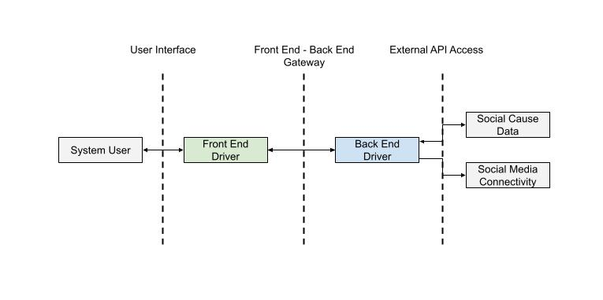
High-Level Architecture

Slide 9
High-Level Architecture: User Interface
The gateway between the System User and the Front-End Driver
Handles user input and packages it to be used in the Front-End Driver
Contains all aspects of the user experience
Choose Image Source
Choose Datasets to be Used
Manipulate Parameters Relevant to Art Generation
Select Output Method for Art Generation
Technology
React

Slide 10
High-Level Architecture: Front-End / Back-End Gateway
The gateway between the Front-End Driver and the Back-End Driver
The space in which messages are sent between the Front-End and Back-End.
All data will pass through this space:
User Commands (Front-End -> Back-End)
Log-In Requests (Front-End -> Back-End)
File Uploads (Datasets, Images, Videos, etc.) (Front-End -> Back-End)
Art Generation Output (Back-End -> Front-End)
System Debug Reports(Back-End -> Front-End)
Technology
HTTP

Slide 11
High-Level Architecture: External API Access
Represents the Back-End Driver accessing External API for gathering social cause data and exporting art generation to social media platforms.
Social Cause Data
NASA
NOAA
EPA
UN
Social Media Connectivity
Snapchat
Facebook
Instagram
X

Slide 12
Front-End Driver

Slide 13
Front-End Driver
Comprises the entirety of Front-End operation
Interacts with the System User and Back-End Driver
Two Components
User Command
System Response
Functionality
Handle User Input
Process User Input
Send User Input to Back-End Driver
Handle Data Sent From Back-End Driver

Slide 14
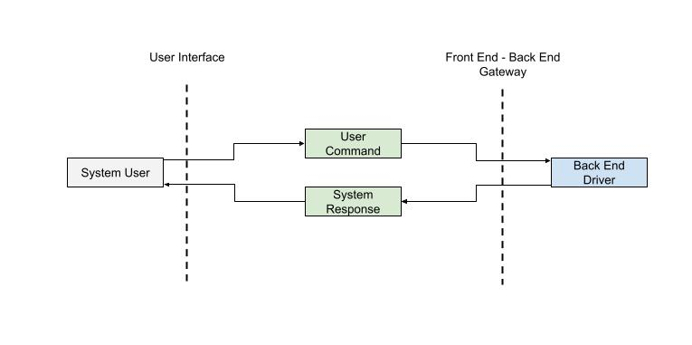
Front-End Driver: Overall Architecture

Slide 15
Front-End Driver: User Command
Converts System User’s commands from the UI to messages to be sent to the Back-End Driver
Example Commands
Select Image Mode
Select Image Source
Select Data Set
Import Data Set
Generate Art
Download File
Export File
Technology
React

Slide 16
Front-End Driver: System Response
Provides the System User with all data relevant to the UI display
Ensures that all outputs related to System User’s input are delivered from the Back-End Driver
Expected Data Examples
Art Generation Output
Error Logging to Report to System User
Technology
React

Slide 17
Back-End Driver

Slide 18
Back-End Driver
Comprises the entirety of Back-End Operation
Interacts with Front-End Driver and External API
Broken in three sections
Back-End Command Interface
Database
Art Generation Driver
Functionality
Heavy Duty Art Generation Computations
Handle System User Input
Output Data to Front-End Driver
User Authentication
Database Storage and Retrieval

Slide 19
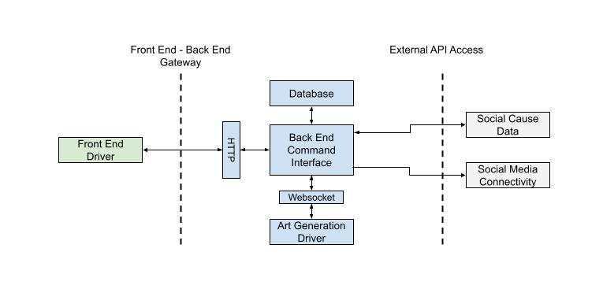
Back-End Driver: Overall Architecture

Slide 20
Back-End Driver: Back-End Command Interface
The mediator for all processing related to the Art Generation Project
Coordinates data transfer between Front-End, External API, and Back-End Subsystems
Functionality
Handle input message from Front-End through HTTP
Perform required processing related to input message
Access user records from database
Generate artwork
Store data into database
Ensure user supplied data is valid
Output required data to Front End
Technology
Flask, HTTP, Python, WebSocket

Slide 21
Back-End Driver: Database
Holds all relevant long term information to be used by the Back-End Driver
Currently, this information relates to user accounts and personal information
User account and login information
User uploaded datasets
Recently generated art by a user
Technology
Python, SQL

Slide 22
Back-End Driver: Art Generation Driver
The most critical component of the Art Generation Project
Drives all art generation
Uses inputs from the user, database, and external API to generate art
Source image / video
Controlling data from database or API
Generation parameters from System User
Connected to the Back-End Command Interface via WebSocket
Technology
Python, TouchDesigner, WebSocket

Slide 23
Looking Forward

Slide 24
Looking Forward: Project Roles
Malique Bodie - User Authentication (Back-End)
David Doan - Command Interface (Back-End)
Alina Kim - Design and Development (Front-End)
Gus LeTourneau - Data Processing (Back-End)
Yingjia Liu - Web Interface (Front-End)
Alexander Pratt - Image Processing (Back-End)
Morgann Thain - Database Functionality (Back-End)
Haiyang Wang - External API Connectivity (Back-End)

Slide 25
Looking Forward: Implementation Goals
<SHOULD WE KEEP THIS SLIDE>

Slide 26
Questions?

Slide 27
Contact Information
Website: https://csci2340.github.io/
Email: alina_kim@brown.edu
Members
Malique Bodie
David Doan
Alina Kim
Gus LeTourneau
Yingjia Liu
Alexander Pratt
Morgann Thain
Haiyang Wang

